Slide 1
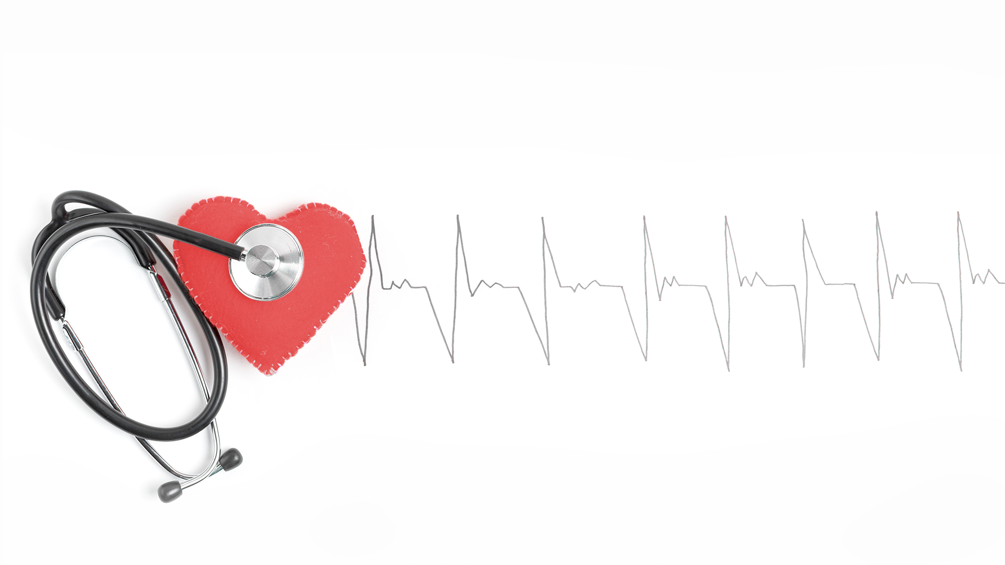
CARDIOVASCULAR DISEASE
Team : Bhagya, Manisha & Nikki

Slide 2
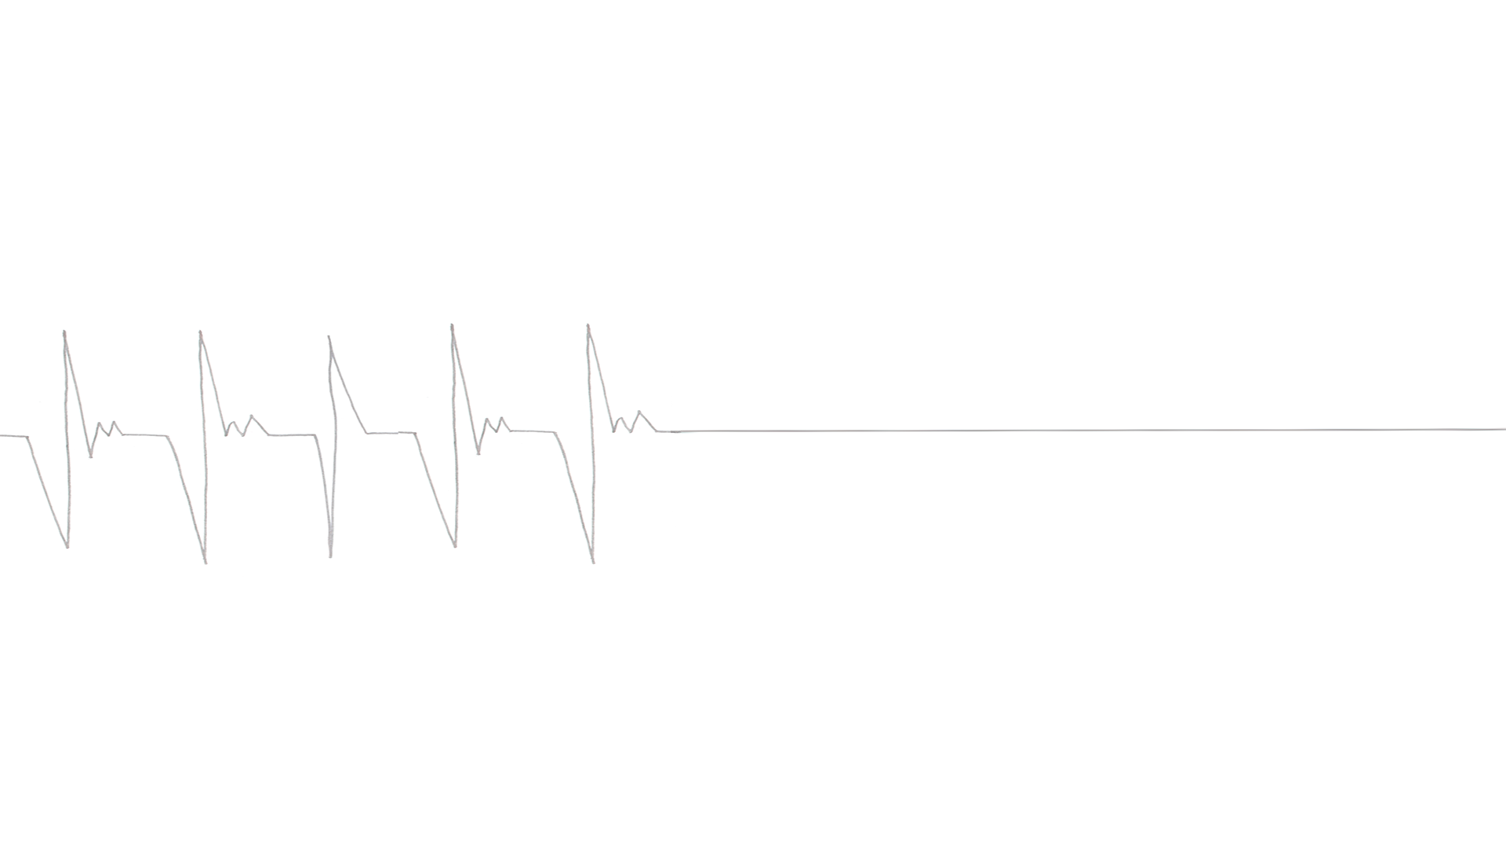
TABLE OF CONTENTS
01
03
05
02
04
INTRODUCTION
MODEL & ANALYSIS
CONCLUSIONS
ANALYSIS
RESULTS
Exploratory Data Analysis

Slide 3

INTRODUCTION
Cardiovascular disease is the No. 1 cause of death among adults of both sexes in the United States.
- Harvard Medical School
Heart attacks are becoming more common in younger people, especially women - American Heart Association Journal
PROBLEM STATEMENT
Which Age groups and Gender are prone to cardiovascular stroke?
To analyze the cardiovascular stroke based on the prevalent factors affecting it and identify which gender group is affected more.

Slide 4

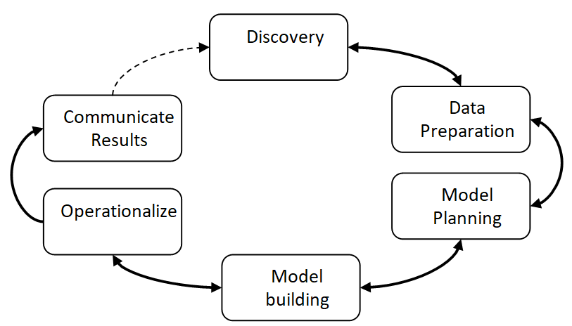
DATA LIFECYCLE

Slide 5

ABOUT THE DATA
Dataset extracted is from Kaggle and consist of more than 4k observation and 17 variables
sex | age | education | currentSmoker | cigsPerDay | BPMeds | prevalent Stroke | prevalentHyp | diabetes | totChol | sysBP | diaBP | BMI | heartRate | glucose | TenYearCHD | Diseases
0 | 66 | 1 | 0 | 0 | 0 | 0 | 1 | 0 | 214 | 212 | 104 | 25.32 | 57 | 84 | 1 | Aortic Aneurysm
0 | 46 | 3 | 0 | 0 | 0 | 0 | 1 | 0 | 237 | 196 | 120 | 31.64 | 58 | 60 | 1 | Aortic Aneurysm
0 | 57 | 1 | 0 | 0 | 0 | 0 | 1 | 0 | 233 | 184 | 106 | 38.88 | 66 | 40 | 1 | Aortic Aneurysm
1 | 59 | 1 | 1 | 3 | 0 | 0 | 1 | 1 | 230 | 182 | 102 | 25.91 | 66 | 147 | 1 | Aortic Aneurysm
0 | 48 | 2 | 0 | 0 | 0 | 0 | 1 | 0 | 224 | 192.5 | 115 | 23.03 | 67 | 85 | 1 | Aortic Aneurysm
0 | 64 | 1 | 0 | 0 | 0 | 0 | 1 | 0 | 194 | 176 | 97 | 33.19 | 68 | 89 | 1 | Aortic Aneurysm
1 | 40 | 1 | 0 | 0 | 0 | 0 | 1 | 0 | 175 | 173 | 59 | 27.99 | 70 | 75 | 1 | Aortic Aneurysm
1 | 57 | 1 | 1 | 3 | 0 | 0 | 1 | 0 | 225 | 177.5 | 120 | 25.48 | 72 | 96 | 1 | Aortic Aneurysm

Slide 6
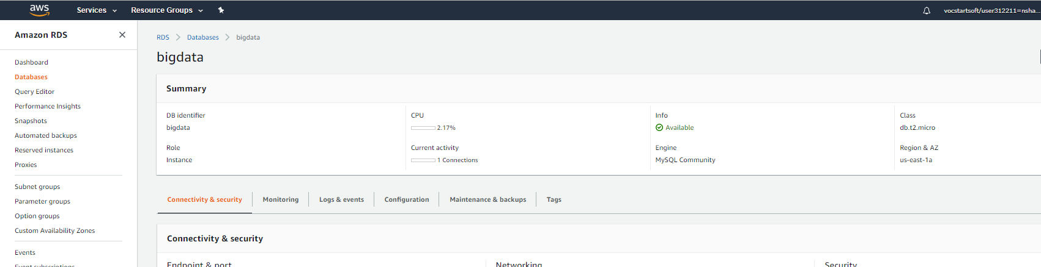
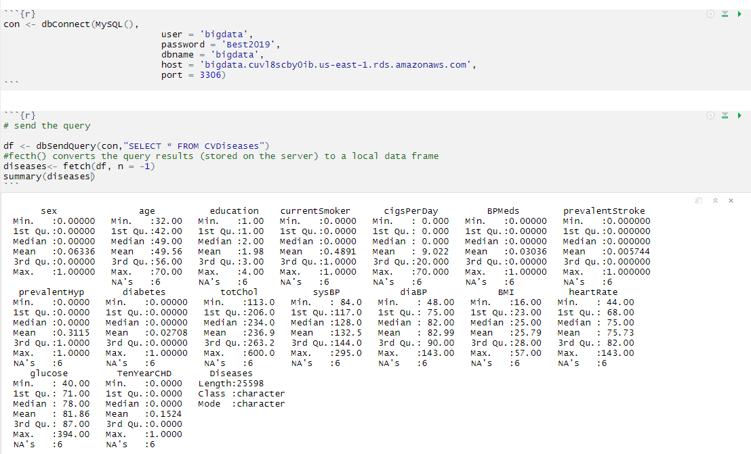
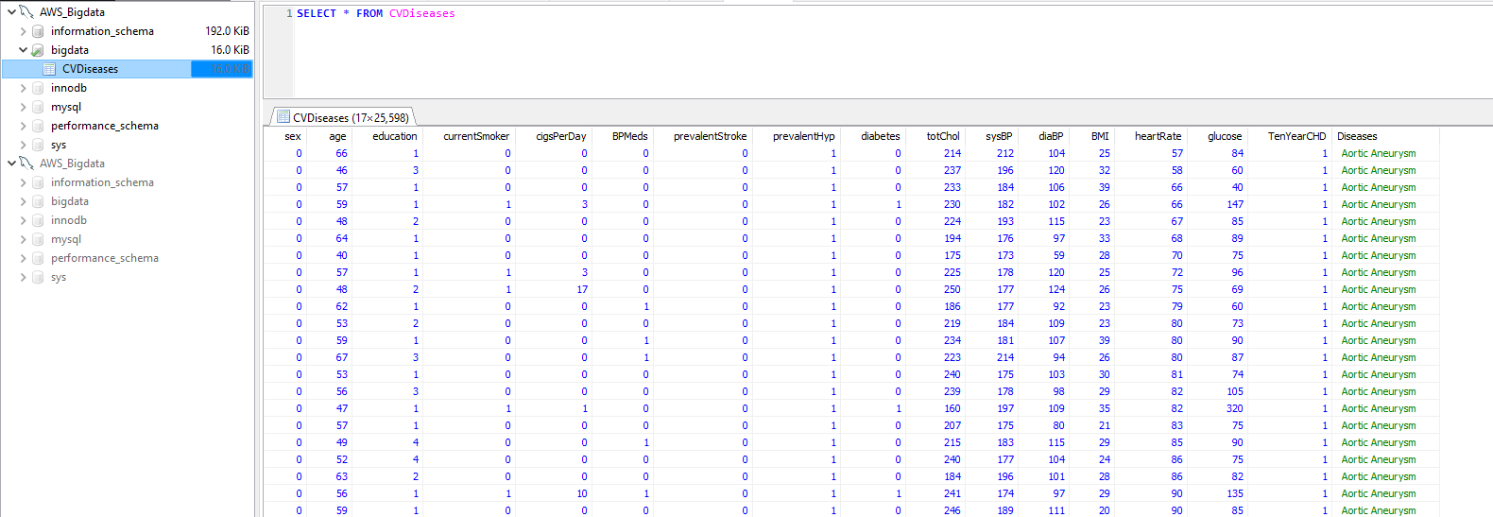
DATA CONNECTION
Data is hosted on cloud using Amazon Web Services and connected to SQL and data is extracted in R studio
AWS DB
SQL Connection
R Connection

Slide 7
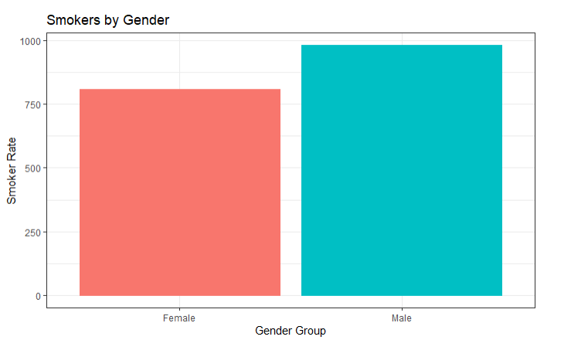
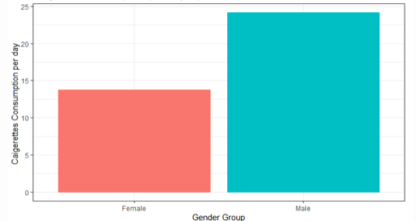

EXPLORATORY DATA ANALYSIS
Smokers Rate count by Gender
Females count is more than 750
Males count is more than 900
Cigarettes consumption per day
A female consumes between 10 - 1 5
A male consumes between 20 -25

Slide 8
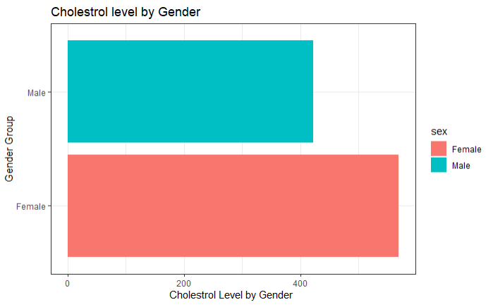
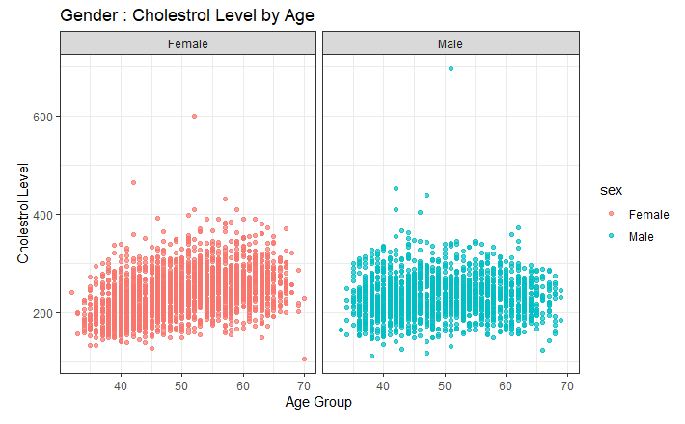

EXPLORATORY DATA ANALYSIS
Cholesterol Level by Gender
Females shows more cholesterol level than Males
GOALS : Total cholesterol less than 200 mg/dl.

Slide 9
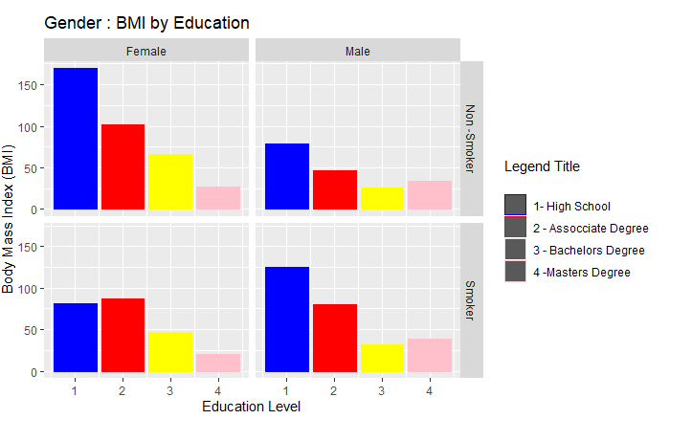
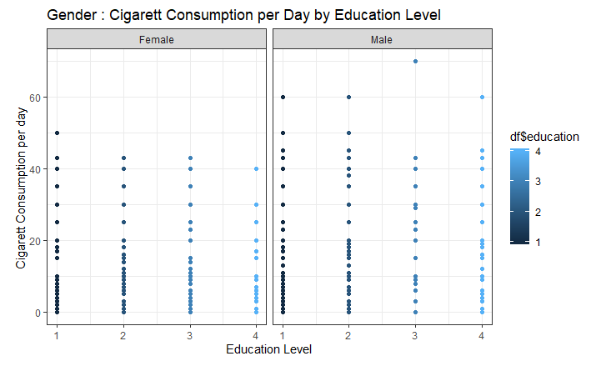

EXPLORATORY DATA ANALYSIS

Slide 10
MODELS & ANALYSIS
CLUSTERING
DECISION TREE
LINEAR REGRESSION
LOGISTIC REGRESSION
Clustering technique was utilized to partition and segment the patient groups based on age for
cardio vascular stroke reported
A Decision Tree is a supervised learning predictive model is used to calculate the heart stroke prediction for the patients based on the prevalent factors
Text Analysis was used to identify the most recorded diseases associated with individuals with CHD
TEXT ANALYSIS
NAÏVE BAYES
Linear regression is used to predict the Heart Rate based on one or more input predictor prevalent to the cardiovascular stroke
Logistic regression is used to predict the Ten year CHD based on one or more input predictor prevalent to the cardiovascular stroke
Naïve Bayes classifiers predictive model is used to compute class membership probabilities of the Heart Stroke Diseases

Slide 11
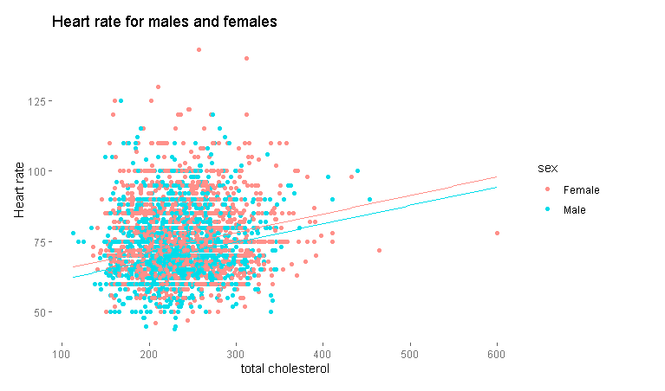
1. MODEL – LINEAR REGRESSION
LINEAR REGRESSION
115.89 beats/min
119.18 beats/min
BACKWARD ELIMINATION
AIC : 16715.07
Quantitative Results of
The Model
FORWARD SELECTION
AIC : 16716.89
Variables selected
Diseases , diaBP , sex , cigsPerDay, glucose , totChol,age ,education , BPMeds
Predicted Heart Rate with variables selected
Male
Female

Slide 12
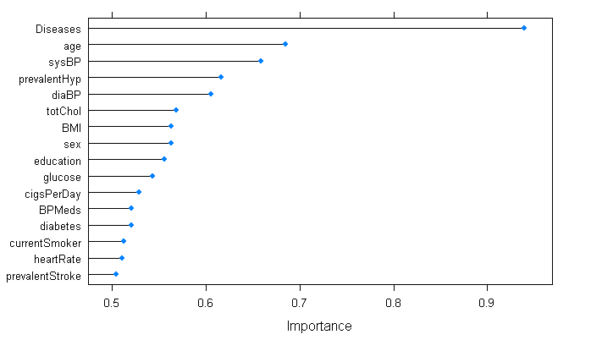
LINEAR REGRESSION – VARIABLE IMPORTANCE
Variable | Importance
Diseases | 0.9389587
age | 0.6853256
sysBP | 0.6587704
prevalentHyp | 0.6169894
diaBP | 0.6059420
totChol | 0.5690597
BMI | 0.5637827
sex | 0.5634183
education | 0.5566126
glucose | 0.5437177

Slide 13
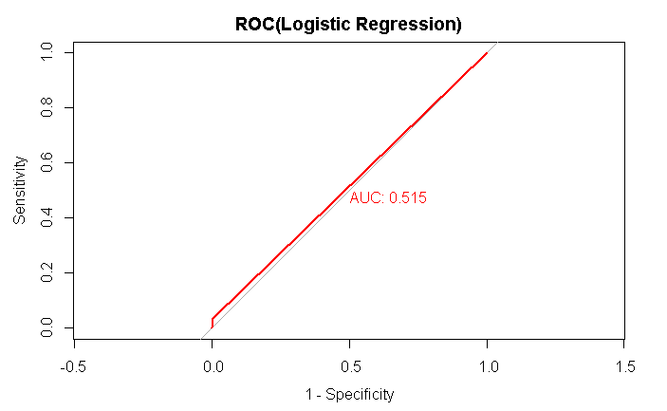
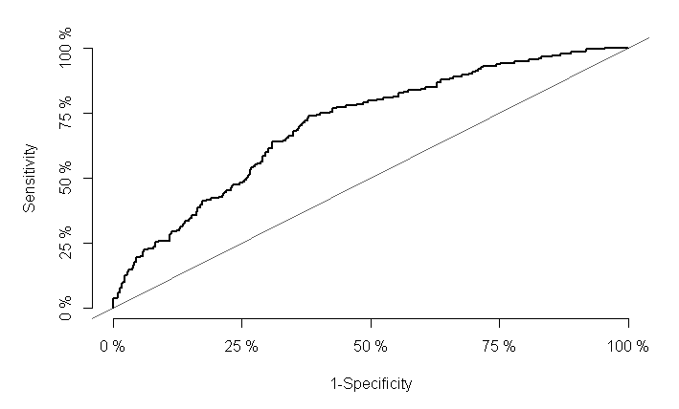
2.LOGISTIC REGRESSION - ROC CURVE
ACCURACY:84.68%
PRECISON : 15.20%
RECALL : 50%

Slide 14
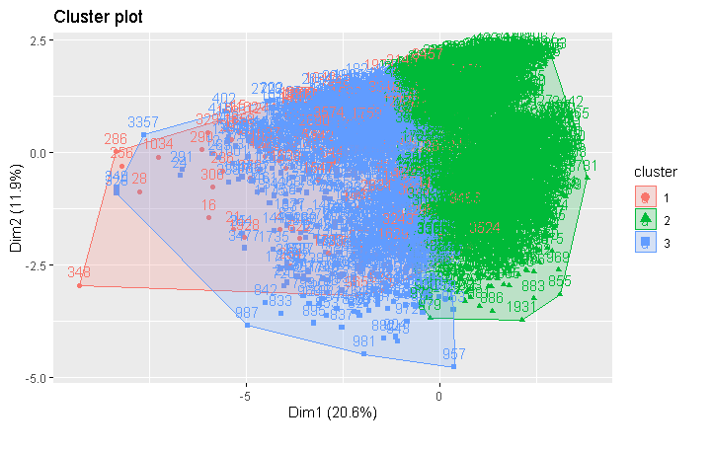
3.MODEL – CLUSTER ANALYSIS
Clusters based on the age group recorded for the coronary heart diseases

Slide 15

4.MODEL – KNN ALGORTIHM
KNN ALGORITHM
ACCURACY
86.10%
 | PREDICTION
ACTUAL | 0 | 1
0 | 782 | 5
1 | 124 | 3
QUANTITATIVE RESULTS
PRECISION
13.89%
RECALL
50%

Slide 16
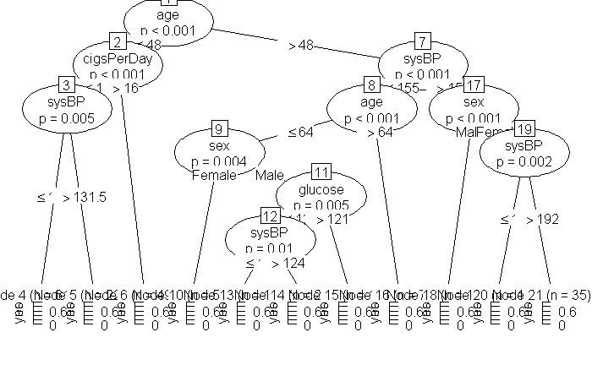
5.MODEL – DECISION TREE
DECISION TREE
ACCURACY
83.80%
QUANTITATIVE RESULTS
FOR DECISION TREE
PRECISION
15.20%
RECALL
50%

Slide 17
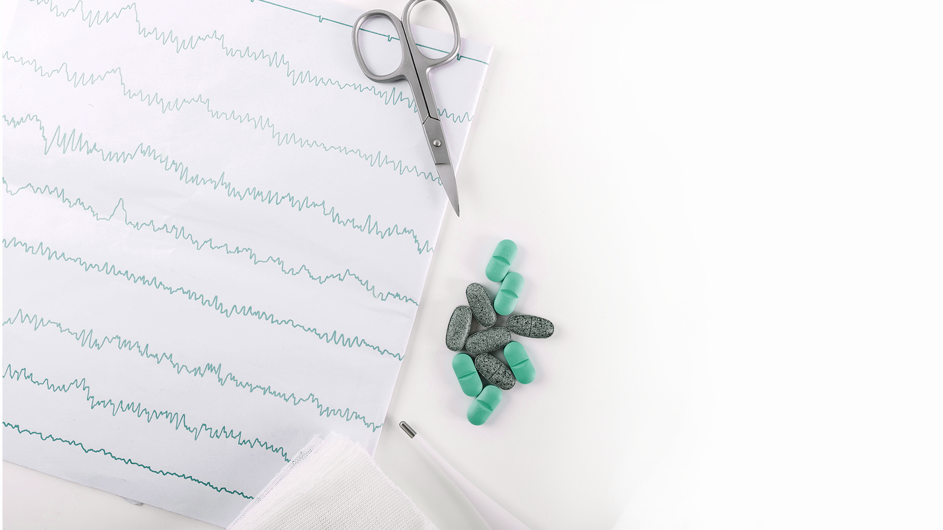
6.MODEL –NAÏVE BAYES ANALYSIS
ACCURACY
94.63%
NAÏVE BAYES ANALYSIS
Quantitative results
PRECISION
15.20%
RECALL
50%

Slide 18
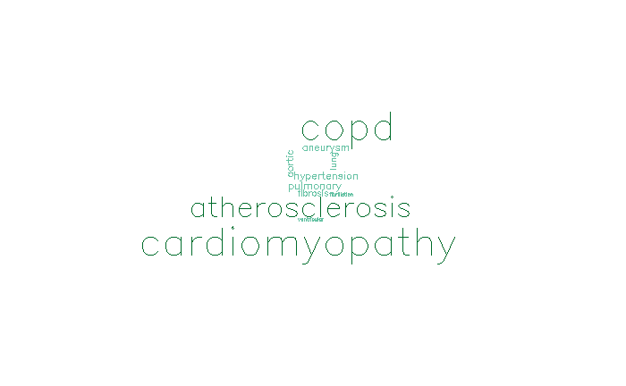
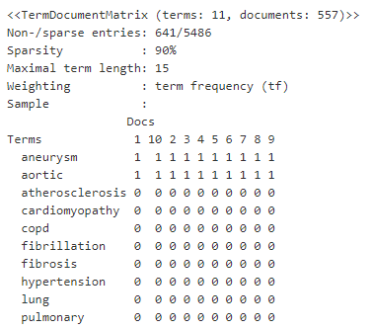
7.TEXT ANALYSIS
Text Analysis was used to identify the most recorded diseases associated with individuals with CHD

Slide 19

MODEL COMPARISON
ANOVA test is used to check the significant difference between the models used for predicting the cardiovascular stroke
NAÏVE BAYES
KNN ALGORITHM
LOGISTIC REGRESSION
DECISION TREE
94.63%
86.10%
84.68%
83.80%
P Value : 2.45e-13

Slide 20
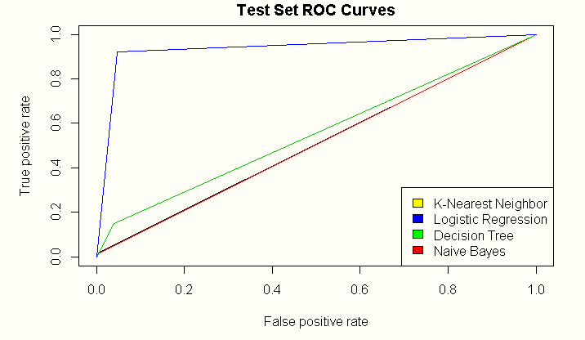
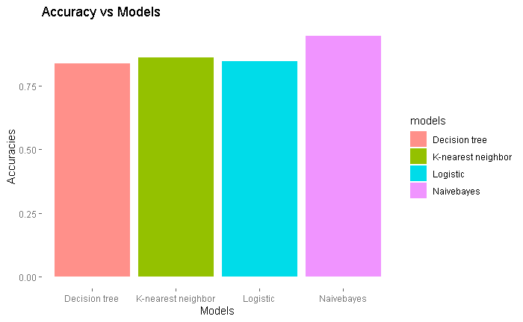

MODEL COMPARISON

Slide 21
RESULTS
Age Group | KNN | Logistic | Decision Tree | Naïve Bayes
 | Predicted | Predicted | Predicted | Predicted
30 – 45 | 12.5% | 40% | 00.0 % | 13.37%
45 – 60 | 50.0% | 40% | 50.0% | 58.13%
60 - 75 | 37.5% | 20% | 50.0% | 28.48%
Gender % | 62.5%(F) | 60%(F) | 75%(M) | 47.6% (F)
Females show higher % of chances of getting affected by cardiovascular diseases.
Individuals of both genders between 45 – 60 age are more prone to CHD

Slide 22

RESULTS
62.5 % FEMALE
40 – 65 AGE GROUP
Cardiomyopathy & COPD
CARDIOVASCULAR STROKE
Affected age group
Diseases reported

Slide 23
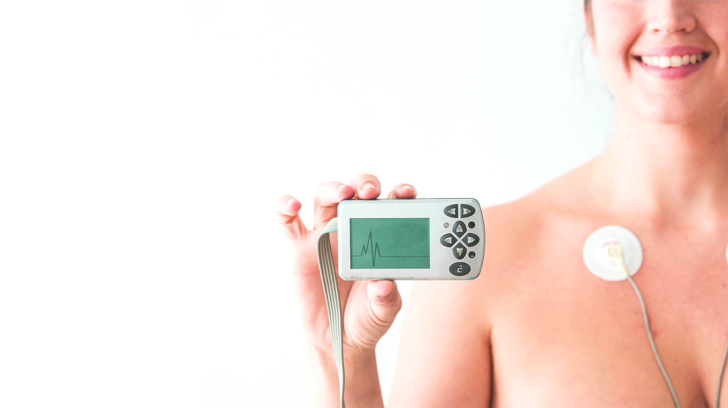
CONCLUSIONS
The analysis resulted in showing that the female group are more prone to heart diseases
Individuals between the age group of 40-65 are more prone to Coronary Heart stroke .
Creating awareness about various heart diseases in the society such that preventive measures can be adopted by people to decrease the mortality rate

Slide 24
REFERENCES
Khosla, Aditya & Cao, Yu & Lin, Cliff & Chiu, Hsu-Kuang & Hu, Junling & Lee, Honglak, “An integrated machine learning approach to stroke prediction”, KDD, pp. 183-191, 2014.
Shadab Adam Pattekari and Asma Parveen, prediction system for heart disease using naïve bayes, International Journal of Advanced Computer and Mathematical Sciences, 2012.
Carlos Ordonez, Edward Omiecinski, Mining Constrained Association Rules to Predict Heart Disease, IEEE. Published in International Conference on Data Mining (ICDM), p. 433- 440, 2001
Douglas G. Manuel, Meltem Tuna,Richard Perez,Peter Tanuseputro,Deirdre Hennessy,Carol Bennett,Laura Rosella,Claudia Sanmartin,Carl van Walraven,Jack V. Tu , “Predicting Stroke Risk Based on Health Behaviors: Development of the Stroke Population Risk Tool (SPoRT)”, PLoS ONE, 2015.

Slide 25

THANKS
Does anyone have any questions?

